Slide 1




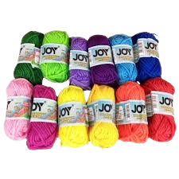
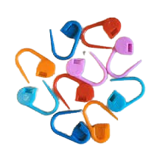
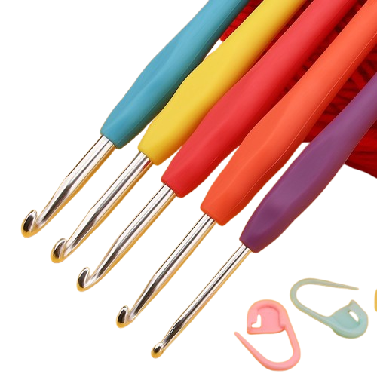





Crochet Kits
Category
Search for Crochet Kits…
Crochet Kits
Buy now Pay later
Yarns
Markers
Hooks
View All
View All
View All
All rights reserved © 2024 Pyat 7
Terms and Policy
About

Slide 2

X

Slide 3
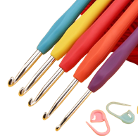
X

Slide 4

X

Slide 5
Markers

Slide 6

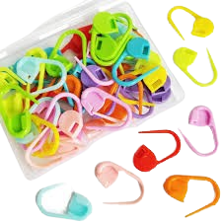
Crochet Kits
Category
Search for Crochet Kits…
Stitch Markers
Buy now Pay later
Product: Stitch Marker
Color: ROYGBV
Stock: 5 Packs
70 ₱
Ratings
Description
₱ 50
70 ₱
Add To Cart
Checkout
All rights reserved © 2024 Pyat 7
Terms and Policy
Terms and Policy
About
About

Slide 7

X

Slide 8
Hooks

Slide 9
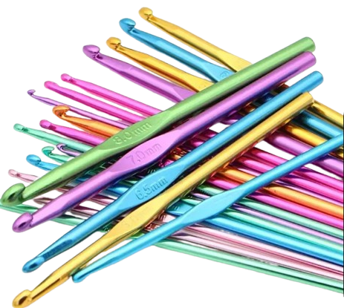
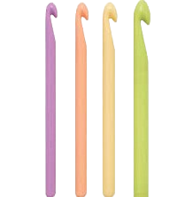
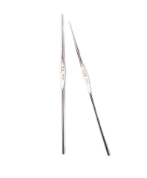
Crochet Kits
Category
Search for Crochet Kits…
Hooks
Buy now Pay later
Aluminum
Plastic
Steel
View All
View All
View All
All rights reserved © 2024 Pyat 7
Terms and Policy
Terms and Policy
About
About

Slide 10
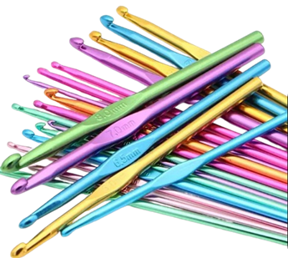
X

Slide 11
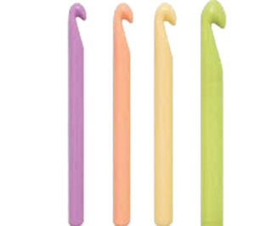
X

Slide 12
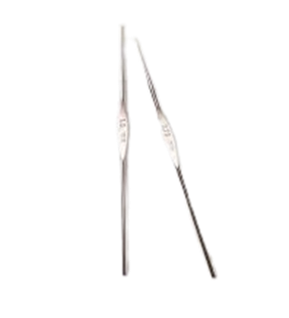
X

Slide 13
Aluminum Hooks

Slide 14
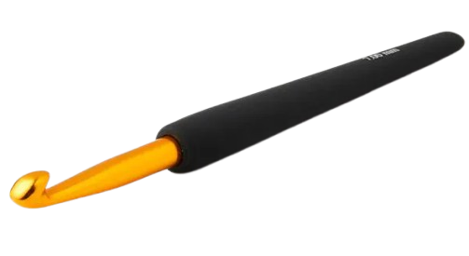
Crochet Kits
Category
Search for Crochet Kits…
Aluminum Hooks
Buy now Pay later
Type: Gold Aluminum Hook
Size: 5.5 mm
Length: 6 Inch
70 ₱
Ratings
Description
230 ₱
70 ₱
Add To Cart
Checkout
All rights reserved © 2024 Pyat 7
Terms and Policy
Terms and Policy
About
About

Slide 15
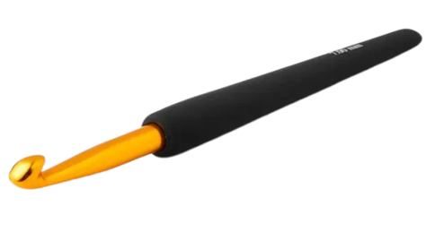
X

Slide 16
Plastic Hooks

Slide 17
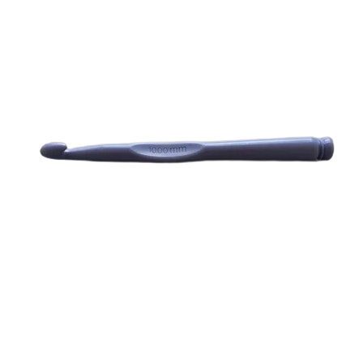
Crochet Kits
Category
Search for Crochet Kits…
Plastic Hooks
Buy now Pay later
Type: Plastic Hook
Size: 5.5 mm
Length: 6 Inch
70 ₱
Ratings
70 ₱
Description
70 ₱
Add To Cart
Checkout
All rights reserved © 2024 Pyat 7
Terms and Policy
Terms and Policy
About
About

Slide 18
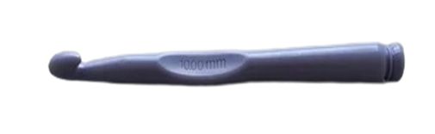
X

Slide 19
Steel Hooks

Slide 20
Crochet Kits
Category
Search for Crochet Kits…
Steel Hooks
Buy now Pay later
Type: Steel Hook
Size: 5.5 mm
Length: 6 Inch
70 ₱
Ratings
Description
300 ₱
70 ₱
Add To Cart
Checkout
All rights reserved © 2024 Pyat 7
Terms and Policy
Terms and Policy
About
About

Slide 21
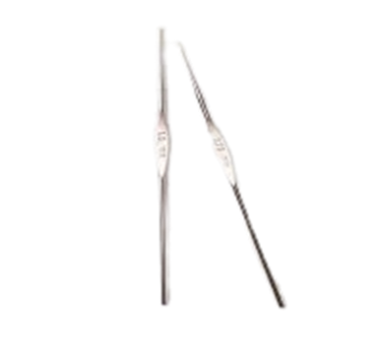
X

Slide 22
Yarns

Slide 23
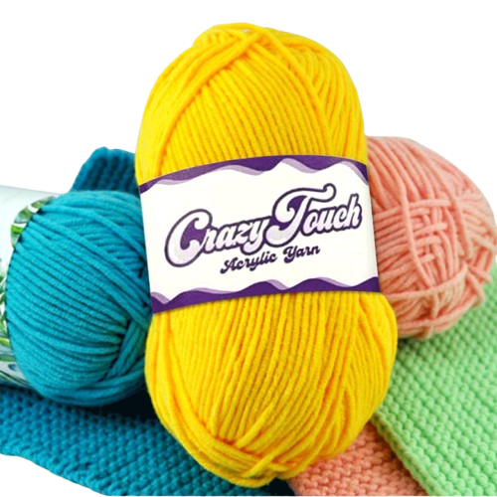
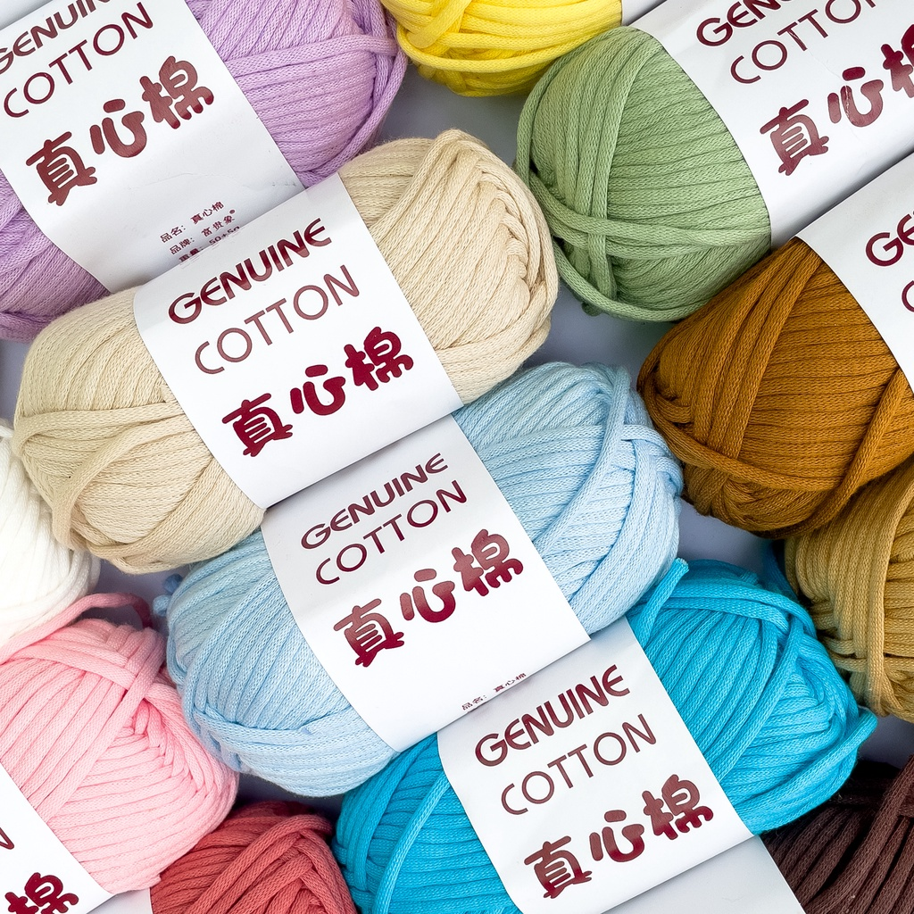
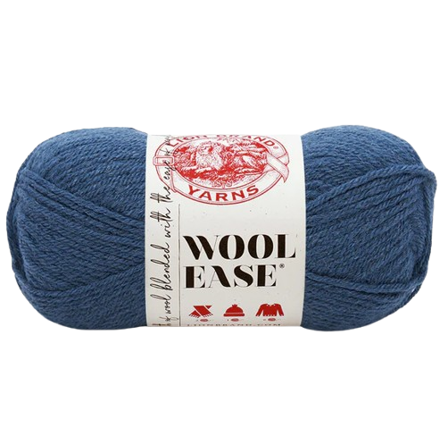
Crochet Kits
Category
Search for Crochet Kits…
Yarns
Buy now Pay later
Acrylic Yarn
Cotton Yarn
Wool Yarn
View All
View All
View All
All rights reserved © 2024 Pyat 7
Terms and Policy
Terms and Policy
About
About

Slide 24

X

Slide 25
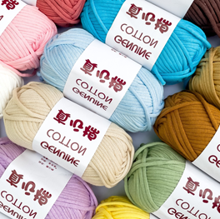
X

Slide 26
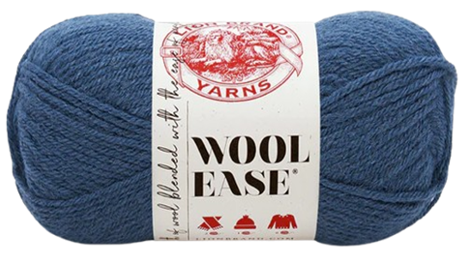
X

Slide 27
Acrylic Yarn

Slide 28
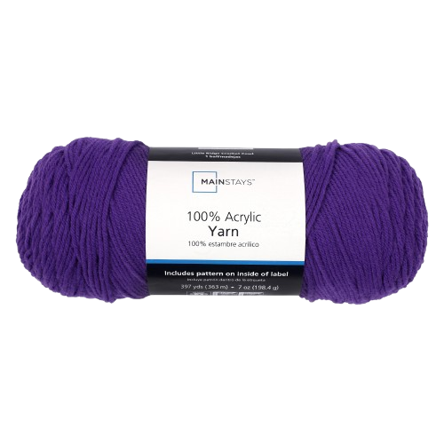
Crochet Kits
Category
Search for Crochet Kits…
Acrylic Yarns
Buy now Pay later
Type: Acrylic Yarn
Recommended Crochet Hook: 5.5 mm
Color: Red
Length: 20m
70 ₱
Ratings
Description
70 ₱
70 ₱
Description
Add To Cart
Checkout
All rights reserved © 2024 Pyat 7
Terms and Policy
Terms and Policy
About
About

Slide 29
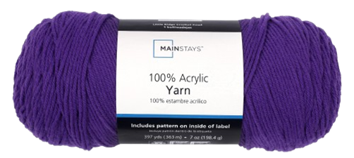
X

Slide 30
Cotton Yarn

Slide 31
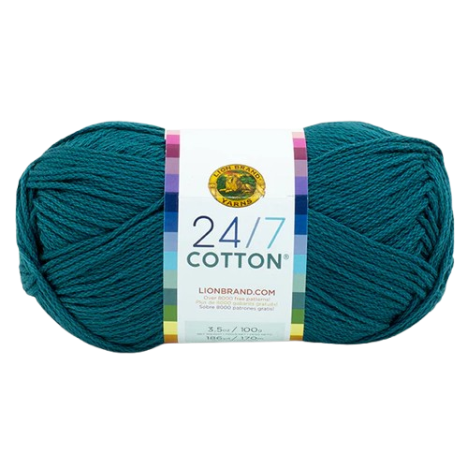
Crochet Kits
Category
Search for Crochet Kits…
Cotton Yarn
Buy now Pay later
Type: Cotton Yarn
Recommended Crochet Hook: 5.5 mm
Color: Blue – Teel
Length: 20m
Ratings
125 ₱
Description
125 ₱
Add To Cart
Checkout
All rights reserved © 2024 Pyat 7
Terms and Policy
Terms and Policy
About
About

Slide 32
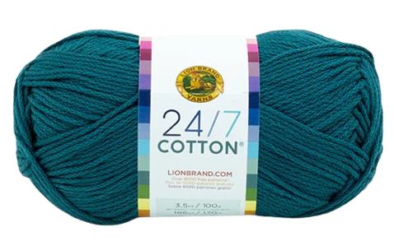
X

Slide 33
Wool Yarn

Slide 34
Crochet Kits
Category
Search for Crochet Kits…
Wool Yarn
Buy now Pay later
Type: Wool Yarn
Recommended Crochet Hook: 5.5 mm
Color: Blue
Length: 20m
Ratings
60 ₱
Description
Add To Cart
Checkout
All rights reserved © 2024 Pyat 7
Terms and Policy
Terms and Policy
About
About

Slide 35
X

Slide 36
Description

Slide 37
Crochet Kits
Category
Search for Crochet Kits…
Acrylic yarn Description
Acrylic yarn is a synthetic fiber yarn made from polyacrylonitrile or polyacrylic. It's a versatile, affordable, and widely used yarn in crochet, knitting, and textile applications.
Properties
Smooth texture, Resistant to wrinkles, washable and dryable, less expensive than natural fibers, Suitable for sensitive skin.
Crochet-Specific Information
Hook sizes: 3.5mm to 10mm
View Ratings
View Product
All rights reserved © 2024 Pyat 7
Terms and Policy
About

Slide 38
Crochet Kits
Category
Search for Crochet Kits…
Cotton yarn Description
Cotton Yarn is a synthetic fiber yarn made from polyacrylonitrile or polyacrylic. It's a versatile, affordable, and widely used yarn in crochet, knitting, and textile applications.
Properties
Smooth texture, Resistant to wrinkles, washable and dryable, less expensive than natural fibers, Suitable for sensitive skin.
Crochet-Specific Information
Hook sizes: 3.5mm to 10mm
View Ratings
View Product
All rights reserved © 2024 Pyat 7
Terms and Policy
About

Slide 39
Crochet Kits
Category
Search for Crochet Kits…
Wool yarn Description
Wool Yarn is a synthetic fiber yarn made from polyacrylonitrile or polyacrylic. It's a versatile, affordable, and widely used yarn in crochet, knitting, and textile applications.
Properties
Smooth texture, Resistant to wrinkles, washable and dryable, less expensive than natural fibers, Suitable for sensitive skin.
Crochet-Specific Information
Hook sizes: 3.5mm to 10mm
View Ratings
View Product
All rights reserved © 2024 Pyat 7
Terms and Policy
About

Slide 40
Crochet Kits
Category
Search for Crochet Kits…
Aluminum Hooks Description
Crafted for durability and versatility, our aluminum hooks are the perfect solution for all your hanging and storage needs. Made from high-quality, lightweight aluminum, these hooks are rust-resistant, sturdy, and designed to last.
Properties
Durable Material, Rust-Resistant, Sleek Design, Easy Installation, Versatile Usage
View Ratings
View Product
All rights reserved © 2024 Pyat 7
Terms and Policy
About

Slide 41
Crochet Kits
Category
Search for Crochet Kits…
Plastic Hooks Description
Plastic hooks are versatile fastening tools or accessories designed to hold, hang, or secure objects. They are typically made from durable plastic materials such as polypropylene, polyethylene, or ABS, making them lightweight, rustproof, and resistant to wear and moisture.
Properties
Durable Material, Rust-Resistant, Sleek Design, Easy Installation, Versatile Usage
View Ratings
View Product
All rights reserved © 2024 Pyat 7
Terms and Policy
About

Slide 42
Crochet Kits
Category
Search for Crochet Kits…
Steel Hooks Description
Steel hooks are versatile tools made from high-strength steel, known for their durability and resistance to wear and corrosion.
Properties
Durable Material, Rust-Resistant, Sleek Design, Easy Installation, Versatile Usage
View Ratings
View Product
All rights reserved © 2024 Pyat 7
Terms and Policy
About

Slide 43
Crochet Kits
Category
Search for Crochet Kits…
Stitch Marker Description
A stitch marker is a small tool used in knitting and crocheting to help keep track of specific points in a project. These markers can be placed directly onto your yarn or slipped onto the knitting needle.
Color:
Red, Orange, Yellow, Green, Blue, Black, Violet
View Ratings
View Product
All rights reserved © 2024 Pyat 7
Terms and Policy
About

Slide 44
Ratings

Slide 45
Acrylic Yarn Ratings

Slide 46

Crochet Kits
Category
Search for Crochet Kits…
Ratings
mark234
4.7
Product: Acrylic Yarn
Color: Blue
Quality: Good
Satisfied: Yes
Thank You seller
Acrylic Yarn
View Product
All rights reserved © 2024 Pyat 7
Terms and Policy
About

Slide 47
Cotton Yarn Ratings

Slide 48
Crochet Kits
Category
Search for Crochet Kits…
Ratings
mark234
4.7
Product: Cotton Yarn
Color: Blue
Quality: Good
Satisfied: Yes
Thank You seller
Wool Yarn
View Product
All rights reserved © 2024 Pyat 7
Terms and Policy
About

Slide 49
Wool Yarn Ratings

Slide 50
Crochet Kits
Category
Search for Crochet Kits…
Ratings
mark234
4.7
Product: Wool Yarn
Color: Blue
Quality: Good
Satisfied: Yes
Thank You seller
Wool Yarn
View Product
All rights reserved © 2024 Pyat 7
Terms and Policy
About

Slide 51
Steel Hooks Ratings

Slide 52
Crochet Kits
Category
Search for Crochet Kits…
Ratings
mark234
4.7
Product: Steel Hook
Color: None
Quality: Good
Satisfied: Yes
Thank You seller
Steel Hook
View Product
All rights reserved © 2024 Pyat 7
Terms and Policy
About

Slide 53
Plastic Hooks Ratings

Slide 54
Crochet Kits
Category
Search for Crochet Kits…
Ratings
mark234
4.7
Product: Steel Hook
Color: None
Quality: Good
Satisfied: Yes
Thank You seller
Plastic Hooks
View Product
All rights reserved © 2024 Pyat 7
Terms and Policy
About

Slide 55
Aluminum Hooks Ratings

Slide 56
Crochet Kits
Category
Search for Crochet Kits…
Ratings
mark234
4.7
Product: Aluminum Hook
Color: None
Quality: Good
Satisfied: Yes
Thank You seller
Aluminum Hooks
View Product
All rights reserved © 2024 Pyat 7
Terms and Policy
About

Slide 57
Marker Ratings

Slide 58
Crochet Kits
Category
Search for Crochet Kits…
Ratings
mark234
4.7
Product: Aluminum Hook
Color: None
Quality: Good
Satisfied: Yes
Thank You seller
Marker
View Product
All rights reserved © 2024 Pyat 7
Terms and Policy
About

Slide 59
Rate

Slide 60


Crochet Kits
Category
Search for Crochet Kits…
Rate
Buy now Pay later
Category: Yarn
Color: Green
Quality: Good Better Best
Satisfied: Yes No
Add Comment Here…
View Product
70 ₱
70 ₱
Done
All rights reserved © 2024 Pyat 7
Terms and Policy
Terms and Policy
About
About

Slide 61
Crochet Kits
Category
Search for Crochet Kits…
Rate
Buy now Pay later
Category: Yarn
Color: Green
Quality: Good Better Best
Satisfied: Yes No
Add Comment Here…
View Product
70 ₱
70 ₱
Done
All rights reserved © 2024 Pyat 7
Terms and Policy
Terms and Policy
About
About

Slide 62
Crochet Kits
Category
Search for Crochet Kits…
Rate
Buy now Pay later
Category: Yarn
Color: Green
Quality: Good Better Best
Satisfied: Yes No
Add Comment Here…
View Product
70 ₱
70 ₱
Done
All rights reserved © 2024 Pyat 7
Terms and Policy
Terms and Policy
About
About

Slide 63
Crochet Kits
Category
Search for Crochet Kits…
Rate
Buy now Pay later
Category: Yarn
Color: Green
Quality: Good Better Best
Satisfied: Yes No
Add Comment Here…
View Product
70 ₱
70 ₱
Done
All rights reserved © 2024 Pyat 7
Terms and Policy
Terms and Policy
About
About

Slide 64
Crochet Kits
Category
Search for Crochet Kits…
Rate
Buy now Pay later
Category: Yarn
Color: Green
Quality: Good Better Best
Satisfied: Yes No
Add Comment Here…
View Product
70 ₱
70 ₱
Done
All rights reserved © 2024 Pyat 7
Terms and Policy
Terms and Policy
About
About

Slide 65
Crochet Kits
Category
Search for Crochet Kits…
Rate
Buy now Pay later
Category: Yarn
Color: Green
Quality: Good Better Best
Satisfied: Yes No
Add Comment Here…
View Product
70 ₱
70 ₱
Done
All rights reserved © 2024 Pyat 7
Terms and Policy
Terms and Policy
About
About

Slide 66
Crochet Kits
Category
Search for Crochet Kits…
Rate
Buy now Pay later
Category: Yarn
Color: Green
Quality: Good Better Best
Satisfied: Yes No
Add Comment Here…
View Product
70 ₱
70 ₱
Done
All rights reserved © 2024 Pyat 7
Terms and Policy
Terms and Policy
About
About

Slide 67
Crochet Kits
Category
Search for Crochet Kits…
Rate
Buy now Pay later
Category: Yarn
Color: Green
Quality: Good Better Best
Satisfied: Yes No
Add Comment Here…
View Product
70 ₱
70 ₱
Done
All rights reserved © 2024 Pyat 7
Terms and Policy
Terms and Policy
About
About

Slide 68
Crochet Kits
Category
Search for Crochet Kits…
Rate
Buy now Pay later
Category: Yarn
Color: Green
Quality: Good Better Best
Satisfied: Yes No
Add Comment Here…
View Product
70 ₱
70 ₱
Done
All rights reserved © 2024 Pyat 7
Terms and Policy
Terms and Policy
About
About

Slide 69
Crochet Kits
Category
Search for Crochet Kits…
Rate
Buy now Pay later
Category: Yarn
Color: Green
Quality: Good Better Best
Satisfied: Yes No
Add Comment Here…
View Product
70 ₱
70 ₱
Done
All rights reserved © 2024 Pyat 7
Terms and Policy
Terms and Policy
About
About

Slide 70
Crochet Kits
Category
Search for Crochet Kits…
Rate
Buy now Pay later
Category: Yarn
Color: Green
Quality: Good Better Best
Satisfied: Yes No
Add Comment Here…
View Product
70 ₱
70 ₱
Done
All rights reserved © 2024 Pyat 7
Terms and Policy
Terms and Policy
About
About

Slide 71
Crochet Kits
Category
Search for Crochet Kits…
Rate
Buy now Pay later
Category: Yarn
Color: Green
Quality: Good Better Best
Satisfied: Yes No
Add Comment Here…
View Product
70 ₱
70 ₱
Done
All rights reserved © 2024 Pyat 7
Terms and Policy
Terms and Policy
About
About

Slide 72
Comment Done

Slide 73

Crochet Kits
Category
Search for Crochet Kits…
Ratings
Buy now Pay later
X
Comment And Rate Done
Ok
70 ₱
70 ₱
All rights reserved © 2024 Pyat 7
Terms and Policy
Terms and Policy
About
About

Slide 74
Add to Cart

Slide 75
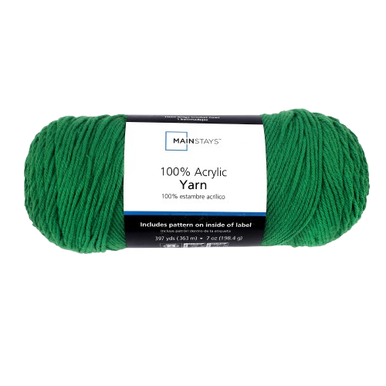

Crochet Kits
Category
Search for Crochet Kits…
Cart
Buy now Pay later
Adds Here
Adds Here
Type: Acrylic Yarn
Recommended Crochet Hook: 5.5 mm
Color: Green
Length: 20m
Quantity: 1
70 ₱
70 ₱
View Product
Checkout
All rights reserved © 2024 Pyat 7
Terms and Policy
Terms and Policy
About
About

Slide 76
Crochet Kits
Category
Search for Crochet Kits…
Cart
Buy now Pay later
Adds Here
Adds Here
Type: Acrylic Yarn
Recommended Crochet Hook: 5.5 mm
Color: Green
Length: 20m
Quantity: 2
70 ₱
70 ₱
View Product
Checkout
All rights reserved © 2024 Pyat 7
Terms and Policy
Terms and Policy
About
About

Slide 77
Crochet Kits
Category
Search for Crochet Kits…
Cart
Buy now Pay later
X
Are you sure you want to delete product in cart?
Yes
No
70 ₱
70 ₱
All rights reserved © 2024 Pyat 7
Terms and Policy
Terms and Policy
About
About

Slide 78
Crochet Kits
Category
Search for Crochet Kits…
Ratings
Buy now Pay later
X
Product Successfully Deleted
Ok
70 ₱
70 ₱
All rights reserved © 2024 Pyat 7
Terms and Policy
Terms and Policy
About
About

Slide 79
Crochet Kits
Category
Search for Crochet Kits…
Cart
Buy now Pay later
Adds Here
Adds Here
Type: Aluminum Hooks
Size: 5.5 mm
Length: 6 Inch
Quantity: 1
70 ₱
70 ₱
View Product
Checkout
All rights reserved © 2024 Pyat 7
Terms and Policy
Terms and Policy
About
About

Slide 80
Crochet Kits
Category
Search for Crochet Kits…
Cart
Buy now Pay later
Adds Here
Adds Here
Type: Aluminum Hooks
Size: 5.5 mm
Length: 6 Inch
Quantity: 2
70 ₱
70 ₱
View Product
Checkout
All rights reserved © 2024 Pyat 7
Terms and Policy
Terms and Policy
About
About

Slide 81
Crochet Kits
Category
Search for Crochet Kits…
Cart
Buy now Pay later
Adds Here
Adds Here
Type: Steel Hooks
Size: 5.5 mm
Length: 6 Inch
Quantity: 1
70 ₱
70 ₱
View Product
Checkout
All rights reserved © 2024 Pyat 7
Terms and Policy
Terms and Policy
About
About

Slide 82
Crochet Kits
Category
Search for Crochet Kits…
Cart
Buy now Pay later
Adds Here
Adds Here
Type: Steel Hooks
Size: 5.5 mm
Length: 6 Inch
Quantity: 2
70 ₱
70 ₱
View Product
Checkout
All rights reserved © 2024 Pyat 7
Terms and Policy
Terms and Policy
About
About

Slide 83
Crochet Kits
Category
Search for Crochet Kits…
Cart
Buy now Pay later
Adds Here
Adds Here
Type: Plastic Hooks
Size: 5.5 mm
Length: 6 Inch
Quantity: 1
70 ₱
70 ₱
View Product
Checkout
All rights reserved © 2024 Pyat 7
Terms and Policy
Terms and Policy
About
About

Slide 84
Crochet Kits
Category
Search for Crochet Kits…
Cart
Buy now Pay later
Adds Here
Adds Here
Type: Plastic Hooks
Size: 5.5 mm
Length: 6 Inch
Quantity: 2
70 ₱
70 ₱
View Product
Checkout
All rights reserved © 2024 Pyat 7
Terms and Policy
Terms and Policy
About
About

Slide 85
Crochet Kits
Category
Search for Crochet Kits…
Cart
Buy now Pay later
Adds Here
Adds Here
Type: Acrylic Yarn
Hook Size: 5.5 mm
Length: 6 Inch
Quantity: 1
70 ₱
70 ₱
View Product
Checkout
All rights reserved © 2024 Pyat 7
Terms and Policy
Terms and Policy
About
About

Slide 86
Crochet Kits
Category
Search for Crochet Kits…
Cart
Buy now Pay later
Adds Here
Adds Here
Type: Acrylic Yarn
Hook Size: 5.5 mm
Length: 6 Inch
Quantity: 2
70 ₱
70 ₱
View Product
Checkout
All rights reserved © 2024 Pyat 7
Terms and Policy
Terms and Policy
About
About

Slide 87
Crochet Kits
Category
Search for Crochet Kits…
Cart
Buy now Pay later
Adds Here
Adds Here
Type: Wool Yarn
Hook Size: 5.5 mm
Length: 6 Inch
Quantity: 1
70 ₱
70 ₱
View Product
Checkout
All rights reserved © 2024 Pyat 7
Terms and Policy
Terms and Policy
About
About

Slide 88
Crochet Kits
Category
Search for Crochet Kits…
Cart
Buy now Pay later
Adds Here
Adds Here
Type: Wool Yarn
Hook Size: 5.5 mm
Length: 6 Inch
Quantity: 2
70 ₱
70 ₱
View Product
Checkout
All rights reserved © 2024 Pyat 7
Terms and Policy
Terms and Policy
About
About

Slide 89
Crochet Kits
Category
Search for Crochet Kits…
Cart
Buy now Pay later
Adds Here
Adds Here
Type: Cotton Yarn
Hook Size: 5.5 mm
Length: 6 Inch
Quantity: 1
70 ₱
70 ₱
View Product
Checkout
All rights reserved © 2024 Pyat 7
Terms and Policy
Terms and Policy
About
About

Slide 90
Crochet Kits
Category
Search for Crochet Kits…
Cart
Buy now Pay later
Adds Here
Adds Here
Type: Cotton Yarn
Hook Size: 5.5 mm
Length: 6 Inch
Quantity: 2
70 ₱
70 ₱
View Product
Checkout
All rights reserved © 2024 Pyat 7
Terms and Policy
Terms and Policy
About
About

Slide 91

Crochet Kits
Category
Search for Crochet Kits…
Cart
Buy now Pay later
Adds Here
Adds Here
Type: Marker
Quantity: 1
70 ₱
70 ₱
View Product
Checkout
All rights reserved © 2024 Pyat 7
Terms and Policy
Terms and Policy
About
About

Slide 92
Crochet Kits
Category
Search for Crochet Kits…
Cart
Buy now Pay later
Adds Here
Adds Here
Type: Marker
Quantity: 2
70 ₱
70 ₱
View Product
Checkout
All rights reserved © 2024 Pyat 7
Terms and Policy
Terms and Policy
About
About

Slide 93
Crochet Kits
Category
Search for Crochet Kits…
Cart
Buy now Pay later
Browse Products And Add to Cart Back to Home Page
Adds Here
Adds Here
70 ₱
70 ₱
All rights reserved © 2024 Pyat 7
Terms and Policy
Terms and Policy
About
About

Slide 94
Crochet Kits
Category
Search for Crochet Kits…
Cart
Buy now Pay later
X
Are you sure you want to delete product in cart?
Yes
No
70 ₱
70 ₱
All rights reserved © 2024 Pyat 7
Terms and Policy
Terms and Policy
About
About

Slide 95
Crochet Kits
Category
Search for Crochet Kits…
Ratings
Buy now Pay later
X
Product Successfully Deleted
Ok
70 ₱
70 ₱
All rights reserved © 2024 Pyat 7
Terms and Policy
Terms and Policy
About
About

Slide 96
Payment Method

Slide 97


Crochet Kits
Category
Search for Crochet Kits…
Payment Method
Buy now Pay later
70 ₱
70 ₱
All rights reserved © 2024 Pyat 7
Terms and Policy
Terms and Policy
About
About

Slide 98
Crochet Kits
Category
Search for Crochet Kits…
Payment Method COD
Buy now Pay later
Buyer: Mark Magsanay
Email: mark20@gmail.com
Mobile No: +639306856120
Address: Purok Cabatingan, Monte Alegre, Aurora, Zamboanga del Sur
Zip Code: 7020
Seller: Group 3 The Pyat 7
Item: Item Name
Shipping Fee: 20
Product Price: 100
Total Price: 120
Product Code: 372dbn44475vgf
70 ₱
70 ₱
Checkout
All rights reserved © 2024 Pyat 7
Terms and Policy
Terms and Policy
About
About

Slide 99
Crochet Kits
Category
Search for Crochet Kits…
Payment Method COD
Buy now Pay later
X
Buyer: Mark Magsanay
Email: mark20@gmail.com
Mobile No: +639306856120
Address: Purok Cabatingan, Monte Alegre, Aurora, Zamboanga del Sur
Zip Code: 7020
Seller: Group 3 The Pyat 7
Item: Item Name
Product Code: 372dbn44475vgf
Ordered Done, View Details
70 ₱
70 ₱
Checkout
All rights reserved © 2024 Pyat 7
Terms and Policy
Terms and Policy
About
About

Slide 100
Crochet Kits
Category
Search for Crochet Kits…
Payment Method GCASH
Buy now Pay later
G-Cash
Enter Number To Log In G-Cash
+639306856120
Next
70 ₱
70 ₱
All rights reserved © 2024 Pyat 7
Terms and Policy
Terms and Policy
About
About

Slide 101
Crochet Kits
Category
Search for Crochet Kits…
Payment Method GCASH
Buy now Pay later
G-Cash
Enter authentication code we sent to +639306856120
- - - - - -
Done
70 ₱
70 ₱
Didn’t get code? Resend
All rights reserved © 2024 Pyat 7
Terms and Policy
Terms and Policy
About
About

Slide 102
Crochet Kits
Category
Search for Crochet Kits…
Payment Method GCASH
Buy now Pay later
G-Cash
Enter 4 Digit G-Cash PIN
- - - -
Done
70 ₱
70 ₱
All rights reserved © 2024 Pyat 7
Terms and Policy
Terms and Policy
About
About

Slide 103
Crochet Kits
Category
Search for Crochet Kits…
Payment Method GCASH
Buy now Pay later
G-Cash
Confirm Pay
Amount: PHP 350
Balance: PHP 1600
Confirm And Pay
70 ₱
70 ₱
All rights reserved © 2024 Pyat 7
Terms and Policy
Terms and Policy
About
About

Slide 104
Crochet Kits
Category
Search for Crochet Kits…
Payment Method GCASH
Buy now Pay later
G-Cash
Please wait while we confirm successful status with G-Cash
Check you phone for G-Cash confirmation response
If You have a trouble visit this Link
70 ₱
70 ₱
All rights reserved © 2024 Pyat 7
Terms and Policy
Terms and Policy
About
About

Slide 105
Shipping Info

Slide 106
Crochet Kits
Category
Search for Crochet Kits…
Shipping Information
Buy now Pay later
To Ship
To Receive
Cancel Orders
Success Orders
Shipping Information
70 ₱
70 ₱
All rights reserved © 2024 Pyat 7
Terms and Policy
Terms and Policy
About
About

Slide 107
Crochet Kits
Category
Search for Crochet Kits…
To Ship
Buy now Pay later
To Ship
To Receive
Cancel Orders
Success Orders
Buyer: Mark Magsanay
Email: mark20@gmail.com
Mobile No: +639306856120
Address: Purok Cabatingan, Monte Alegre, Aurora, Zamboanga del Sur
Zip Code: 7020
Seller: Group 3 The Pyat 7
Item: Product Name
Quantity: 1
Product Code: 372dbn44475vgf
Total Price: 120
Progress: To Ship
70 ₱
70 ₱
All rights reserved © 2024 Pyat 7
Terms and Policy
Terms and Policy
About
About

Slide 108
Crochet Kits
Category
Search for Crochet Kits…
To Receive
Buy now Pay later
To Ship
To Receive
Cancel Orders
Success Orders
Buyer: Mark Magsanay
Email: mark20@gmail.com
Mobile No: +639306856120
Address: Purok Cabatingan, Monte Alegre, Aurora, Zamboanga del Sur
Zip Code: 7020
Seller: Group 3 The Pyat 7
Item: Product Name
Quantity: 1
Product Code: 372dbn44475vgf
Total Price: 120
Progress: To Receive [Expected date: 12/15/24 – 12/17/24]
70 ₱
70 ₱
All rights reserved © 2024 Pyat 7
Terms and Policy
Terms and Policy
About
About

Slide 109

Crochet Kits
Category
Search for Crochet Kits…
To Receive
Buy now Pay later
To Ship
To Receive
Cancel Orders
Success Orders
Buyer: Mark Magsanay
Email: mark20@gmail.com
Mobile No: +639306856120
Address: Purok Cabatingan, Monte Alegre, Aurora, Zamboanga del Sur
Zip Code: 7020
Seller: Group 3 The Pyat 7
Item: Item: Product Name
Quantity: 1
Product Code: 372dbn44475vgf
Total Price: 120
Progress: Thanks For ordering, Rate Your Product satisfaction Here
70 ₱
70 ₱
All rights reserved © 2024 Pyat 7
Terms and Policy
Terms and Policy
About
About

Slide 110

Crochet Kits
Category
Search for Crochet Kits…
Cancel Orders
Buy now Pay later
To Ship
To Receive
Cancel Orders
Success Orders
Acrylic Yarn
Plastic Hooks
Marker
70 ₱
70 ₱
All rights reserved © 2024 Pyat 7
Terms and Policy
Terms and Policy
About
About

Slide 111
Account

Slide 112
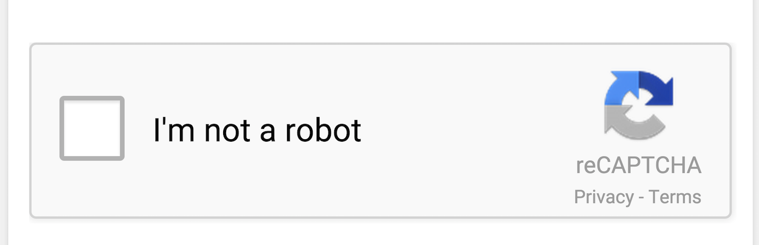
Crochet Kits
Category
Search for Crochet Kits…
Sign Up
Already Have an Account? Sign in Here
Log In as Admin
Email
Password
Confirm Password
Mobile Number
60 ₱
60 ₱
Sign Up
All rights reserved © 2024 Pyat 7
Terms and Policy
Terms and Policy
About
About

Slide 113
Crochet Kits
Category
Search for Crochet Kits…
Sign Up
Already Have an Account? Sign in Here
Enter the verification code we sent in your mobile number +63*******120
Didn’t get the code?
Resend
Enter 6 Digit Code
60 ₱
60 ₱
Continue
All rights reserved © 2024 Pyat 7
Terms and Policy
Terms and Policy
About
About

Slide 114
Crochet Kits
Category
Search for Crochet Kits…
Sign Up
Already Have an Account? Sign in Here
Fill Up The Form Legibly
Enter the verification code we sent in your mobile number +63*******120
Didn’t get the code?
Username
Location
Resend
Birthdate
Enter 6 Digit Code
60 ₱
60 ₱
Continue
All rights reserved © 2024 Pyat 7
Terms and Policy
Terms and Policy
About
About

Slide 115
Crochet Kits
Category
Search for Crochet Kits…
Sign Up
Already Have an Account? Sign in Here
Fill Up The Form Legibly
Enter the verification code we sent in your mobile number +63*******120
Didn’t get the code?
Mark234
Location
Resend
Birthdate
Enter 6 Digit Code
60 ₱
60 ₱
Continue
All rights reserved © 2024 Pyat 7
Terms and Policy
Terms and Policy
About
About

Slide 116
Crochet Kits
Category
Search for Crochet Kits…
Sign Up
Already Have an Account? Sign in Here
Fill Up The Form Legibly
Enter the verification code we sent in your mobile number +63*******120
Didn’t get the code?
Mark234
Select or Search Your Location
Resend
Purok Cabatingan, Monte Alegre, Aurora, Zamboanga del Sur
Zamboanga del Norte
Enter 6 Digit Code
60 ₱
60 ₱
Continue
All rights reserved © 2024 Pyat 7
Terms and Policy
Terms and Policy
About
About

Slide 117
Crochet Kits
Category
Search for Crochet Kits…
Sign Up
Already Have an Account? Sign in Here
Fill Up The Form Legibly
Enter the verification code we sent in your mobile number +63*******120
Didn’t get the code?
Mark234
Purok Cabatingan, Monte Alegre, Aurora, Zamboanga del Sur
Resend
Birthdate
Enter 6 Digit Code
60 ₱
60 ₱
Continue
All rights reserved © 2024 Pyat 7
Terms and Policy
Terms and Policy
About
About

Slide 118
Crochet Kits
Category
Search for Crochet Kits…
Sign Up
Already Have an Account? Sign in Here
Fill Up The Form Legibly
Enter the verification code we sent in your mobile number +63*******120
Didn’t get the code?
Mark234
Purok Cabatingan, Monte Alegre, Aurora, Zamboanga del Sur
Resend
12/14/2003
Enter 6 Digit Code
60 ₱
60 ₱
Continue
All rights reserved © 2024 Pyat 7
Terms and Policy
Terms and Policy
About
About

Slide 119
Crochet Kits
Category
Search for Crochet Kits…
Sign Up
Already Have an Account? Sign in Here
Enter the verification code we sent in your mobile number +63*******120
Didn’t get the code?
Account Successfully Created
Mark234
Resend
Enter 6 Digit Code
60 ₱
60 ₱
Continue
All rights reserved © 2024 Pyat 7
Terms and Policy
Terms and Policy
About
About

Slide 120
Crochet Kits
Category
Search for Crochet Kits…
Sign Up
Already Have an Account? Sign in Here
X
Enter the verification code we sent in your mobile number +63*******120
Didn’t get the code?
Successfully Logged In
Return to Home
Resend
Enter 6 Digit Code
60 ₱
60 ₱
Continue
All rights reserved © 2024 Pyat 7
Terms and Policy
Terms and Policy
About
About

Slide 121
Crochet Kits
Category
Search for Crochet Kits…
Sign In
Don’t Have an Account? Sign Up Here
Log In as Admin
Email
Password
Forgot Password?
60 ₱
60 ₱
Sign In
All rights reserved © 2024 Pyat 7
Terms and Policy
About
Terms and Policy
About

Slide 122
Crochet Kits
Category
Search for Crochet Kits…
Recover Account
Enter Your Crochet account mobile number to recover account
Mobile No.
Back to Log In Page
60 ₱
60 ₱
Next
All rights reserved © 2024 Pyat 7
Terms and Policy
Terms and Policy
About
About

Slide 123
Crochet Kits
Category
Search for Crochet Kits…
Recover Account
Is this you? Enter the five digit verification code we sent to +639306856120
XXXXX
Back to Log In Page
60 ₱
60 ₱
Done
All rights reserved © 2024 Pyat 7
Terms and Policy
Terms and Policy
About
About

Slide 124
Crochet Kits
Category
Search for Crochet Kits…
Recover Account
Is this you? Enter the five digit verification code we sent to +639306856120
Your Account Recovered
Email: mark@gmail.com
Username: mark234
Password: tahimiklangsimark
XXXXX
Back to Log in Page
Back to Log In Page
60 ₱
60 ₱
Done
All rights reserved © 2024 Pyat 7
Terms and Policy
Terms and Policy
About
About

Slide 125
Search Queue

Slide 126
Crochet Kits
Category
Search for Crochet Kits…
Search Queue Will Appear Here
60 ₱
60 ₱
All rights reserved © 2024 Pyat 7
Terms and Policy
Terms and Policy
About
About

Slide 127
Tearms And Condition

Slide 128
Crochet Kits
Category
Search for Crochet Kits…
Terms and Policy
Acceptance of Terms
By using this website and purchasing crochet kits and tools from Ecommerce Crochet Kits, you agree to comply with these Terms and Conditions. If you disagree with any part of the terms, you must not use the website.
Use of Website
You are permitted to access and use this website for personal and non-commercial purposes only. You may not use our services for illegal or unauthorized activities.
Products
We offer a variety of crochet kits, tools, yarns, patterns, and accessories. Product descriptions, images, and prices are accurate to the best of our ability, but we cannot guarantee that all details are error-free. The availability of products may change without notice.
60 ₱
60 ₱
All rights reserved © 2024 Pyat 7
Terms and Policy
Terms and Policy
About
About

Slide 129
About

Slide 130
Crochet Kits
Category
Search for Crochet Kits…
About
About Us
At , Ecommerce Crochet Kits we’re passionate about bringing the art of crochet to life. Whether you’re a seasoned crocheted or just starting your creative journey, we offer carefully curated crochet kits, tools, and accessories to help you create beautiful handmade projects. Our kits are designed to inspire creativity, with everything you need to get started yarn, patterns, and high-quality tools all in one place. Join our crafting community and discover the joy of creating with crochet!
60 ₱
60 ₱
All rights reserved © 2024 Pyat 7
Terms and Policy
Terms and Policy
About
About

Slide 131
Admin Panel

Slide 132


Admin
Username
Password
Sign In
All rights reserved © 2024 Pyat 7

Slide 133
Admin
Category
Products
Yarns
Markers
Hooks
View All
Delete
View All
Delete
View All
Delete
All rights reserved © 2024 Pyat 7
Terms and Policy
About

Slide 134
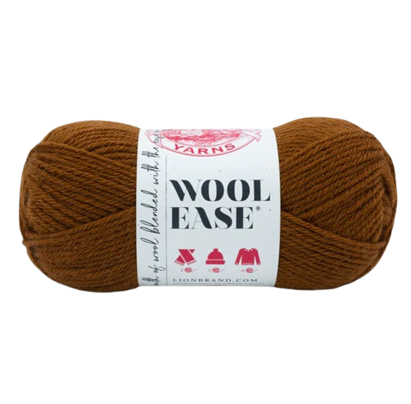
Admin
Category
Yarns
X
Are You Sure You Want To Delete This Category?
No
Yes
Acrylic Yarn
Cotton Yarn
Wool Yarn
Mark234 and 1.3k others
Mark234 and 1.3k others
Mark234 and 1.3k others
Description
Description
Description
Delete
Edit
Delete
Edit
Delete
Edit
All rights reserved © 2024 Pyat 7
Terms and Policy
About

Slide 135
Admin
Category
Yarns
X
Yarn Category Successfully Deleted
Ok
Acrylic Yarn
Cotton Yarn
Wool Yarn
Mark234 and 1.3k others
Mark234 and 1.3k others
Mark234 and 1.3k others
Description
Description
Description
Delete
Edit
Delete
Edit
Delete
Edit
All rights reserved © 2024 Pyat 7
Terms and Policy
About

Slide 136
Admin
Category
Products
Markers
Hooks
View All
Delete
View All
Delete
All rights reserved © 2024 Pyat 7
Terms and Policy
About

Slide 137
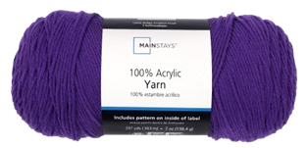
Admin
Category
Yarns
Acrylic Yarn
Cotton Yarn
Wool Yarn
Mark234 and 1.3k others
Mark234 and 1.3k others
Mark234 and 1.3k others
Description
Description
Description
Delete
Edit
Delete
Edit
Delete
Edit
All rights reserved © 2024 Pyat 7
Terms and Policy
About

Slide 138
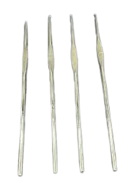
Admin
Category
Hooks
Steel
Plastic
Aluminum
Mark234 and 1.3k others
Mark234 and 1.3k others
Mark234 and 1.3k others
Description
Description
Description
Delete
Edit
Delete
Edit
Delete
Edit
All rights reserved © 2024 Pyat 7
Terms and Policy
About

Slide 139
Admin
Category
Marker
Markers
Mark234 and 1.3k others
Description
Delete
Edit
All rights reserved © 2024 Pyat 7
Terms and Policy
About

Slide 140
Admin
Category
Yarns
X
Are You Sure You Want To Delete This Product?
No
Yes
Acrylic Yarn
Cotton Yarn
Wool Yarn
Mark234 and 1.3k others
Mark234 and 1.3k others
Mark234 and 1.3k others
Description
Description
Description
Delete
Edit
Delete
Edit
Delete
Edit
All rights reserved © 2024 Pyat 7
Terms and Policy
About

Slide 141
Admin
Category
Yarns
X
Product Successfully Deleted
Ok
Acrylic Yarn
Cotton Yarn
Wool Yarn
Mark234 and 1.3k others
Mark234 and 1.3k others
Mark234 and 1.3k others
Description
Description
Description
Delete
Edit
Delete
Edit
Delete
Edit
All rights reserved © 2024 Pyat 7
Terms and Policy
About

Slide 142
Admin
Category
Yarns
Undo
Cotton Yarn
Wool Yarn
Mark234 and 1.3k others
Mark234 and 1.3k others
Description
Description
Delete
Edit
Delete
Edit
All rights reserved © 2024 Pyat 7
Terms and Policy
About

Slide 143

Admin
Category
Comments
mark234
4.7
Thank You seller
Acrylic Yarn
Edit
12-01-2024
All rights reserved © 2024 Pyat 7
Terms and Policy
About

Slide 144
Yarn Description

Slide 145

Admin
Category
Yarn Description
Categories:
Yarn
Markers
Hooks
Acrylic
Cotton
Wool
Stich Markers
Aluminum
Plastic
Steel
Description
Acrylic yarn is a synthetic fiber yarn made from polyacrylonitrile or polyacrylic. It's a versatile, affordable, and widely used yarn in crochet, knitting, and textile applications.
Hook Sizes
Upload Image
3.5mm to 10mm
Properties
View Product
Durable Material, Rust-Resistant, Sleek Design, Easy Installation, Versatile Usage
Save
All rights reserved © 2024 Pyat 7
Terms and Policy
About

Slide 146

Admin
Category
Yarn Description
Categories:
Yarn
Markers
Hooks
Acrylic
Cotton
Wool
Stich Markers
Aluminum
Plastic
Steel
Description
Cotton Yarn is a synthetic fiber yarn made from polyacrylonitrile or polyacrylic. It's a versatile, affordable, and widely used yarn in crochet, knitting, and textile applications.
Hook Sizes
Upload Image
3.5mm to 10mm
Properties
View Product
Durable Material, Rust-Resistant, Sleek Design, Easy Installation, Versatile Usage
Save
All rights reserved © 2024 Pyat 7
Terms and Policy
About

Slide 147

Admin
Category
Yarn Description
Categories:
Yarn
Markers
Hooks
Acrylic
Cotton
Wool
Stich Markers
Aluminum
Plastic
Steel
Description
Wool Yarn is a synthetic fiber yarn made from polyacrylonitrile or polyacrylic. It's a versatile, affordable, and widely used yarn in crochet, knitting, and textile applications.
Hook Sizes
Upload Image
3.5mm to 10mm
Properties
View Product
Durable Material, Rust-Resistant, Sleek Design, Easy Installation, Versatile Usage
Save
All rights reserved © 2024 Pyat 7
Terms and Policy
About

Slide 148
Markers Description

Slide 149
Admin
Category
Markers Description
Categories:
Yarn
Markers
Hooks
Acrylic
Cotton
Wool
Stich Markers
Aluminum
Plastic
Steel
Description
A stitch marker is a small tool used in knitting and crocheting to help keep track of specific points in a project. These markers can be placed directly onto your yarn or slipped onto the knitting needle.
Color
Upload Image
Red, Orange, Green, Blue, Black, Violet
View Product
Save
All rights reserved © 2024 Pyat 7
Terms and Policy
About

Slide 150
Hooks Description

Slide 151
Admin
Category
Hooks Description
Categories:
Yarn
Markers
Hooks
Acrylic
Cotton
Wool
Stich Markers
Aluminum
Plastic
Steel
Description
Crafted for durability and versatility, our aluminum hooks are the perfect solution for all your hanging and storage needs. Made from high-quality, lightweight aluminum, these hooks are rust-resistant, sturdy, and designed to last.
Sizes
Upload Image
3.5mm to 10mm
Properties
View Product
Durable Material, Rust-Resistant, Sleek Design, Easy Installation, Versatile Usage
Save
All rights reserved © 2024 Pyat 7
Terms and Policy
About

Slide 152
Admin
Category
Hooks Description
Categories:
Yarn
Markers
Hooks
Acrylic
Cotton
Wool
Stich Markers
Aluminum
Plastic
Steel
Description
Plastic hooks are versatile fastening tools or accessories designed to hold, hang, or secure objects. They are typically made from durable plastic materials such as polypropylene, polyethylene, or ABS, making them lightweight, rustproof, and resistant to wear and moisture.
Sizes
Upload Image
3.5mm to 10mm
Properties
View Product
Durable Material, Rust-Resistant, Sleek Design, Easy Installation, Versatile Usage
Save
All rights reserved © 2024 Pyat 7
Terms and Policy
About

Slide 153
Admin
Category
Hooks Description
Categories:
Yarn
Markers
Hooks
Acrylic
Cotton
Wool
Stich Markers
Aluminum
Plastic
Steel
Description
Steel hooks are versatile tools made from high-strength steel, known for their durability and resistance to wear and corrosion.
Sizes
Upload Image
3.5mm to 10mm
Properties
View Product
Durable Material, Rust-Resistant, Sleek Design, Easy Installation, Versatile Usage
Save
All rights reserved © 2024 Pyat 7
Terms and Policy
About

Slide 154
Admin
Category
Hooks Description
Categories:
Yarn
Markers
Hooks
Done
Acrylic
Cotton
Wool
Stich Markers
Aluminum
Plastic
Steel
Description
Steel hooks are versatile tools made from high-strength steel, known for their durability and resistance to wear and corrosion.
Ok
Sizes
Upload Image
3.5mm to 10mm
Properties
Durable Material, Rust-Resistant, Sleek Design, Easy Installation, Versatile Usage
Save
All rights reserved © 2024 Pyat 7
Terms and Policy
About

Slide 155
Profile

Slide 156
Crochet Kits
Category
Search for Crochet Kits…
Your Profile
Username
Mark234
Address
Purok Cabatingan , Monte Alegre, Aurora, Zamboanga del Sur
Birth Date
Dec, 14, 2003
Mobile No.
+639306856120
Upload Image
60 ₱
60 ₱
Save
All rights reserved © 2024 Pyat 7
Terms and Policy
Terms and Policy
About
About

Slide 157
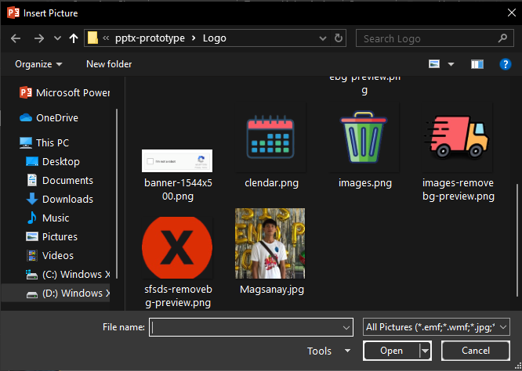

Crochet Kits
Category
Search for Crochet Kits…
Your Profile
Username
Mark234
Address
Ceniza Street, Poblacion, Aurora, Zamboanga delSur
Birth Date
Dec, 14, 2003
Upload Image
60 ₱
60 ₱
Save
All rights reserved © 2024 Pyat 7
Terms and Policy
Terms and Policy
About
About

Slide 158
Crochet Kits
Category
Search for Crochet Kits…
Your Profile
Username
Mark234
Address
Purok Cabatingan , Monte Alegre, Aurora, Zamboanga del Sur
Birth Date
Dec, 14, 2003
Mobile No.
+639306856120
Upload Image
60 ₱
60 ₱
Save
All rights reserved © 2024 Pyat 7
Terms and Policy
Terms and Policy
About
About

Slide 159
Crochet Kits
Category
Search for Crochet Kits…
Your Profile
Username
Mark234
Done
Address
Ceniza Street, Poblacion, Aurora, Zamboanga delSur
Birth Date
Dec, 14, 2003
Ok
Upload Image
60 ₱
60 ₱
Save
All rights reserved © 2024 Pyat 7
Terms and Policy
Terms and Policy
About
About

